Slide 1
Use Case Diagram

Slide 2
Outline
Use Case Diagrams
Formal introduction
UML notation
Examples

Slide 3
A use case diagram presents interactions between the system and other systems or with the system’s users, who are called actors
Actors represent roles which may include human users, external hardware or other systems.
It describes who will use the system and the ways in which a user will interact with the system to achieve a certain goal.
Usually, the diagram is accompanied by a narrative description, which details, in a structured manner, the steps of each interaction

Slide 4
The use case technique enables creating an initial description of the users’ needs, so that later on the system’s behavior can be defined by using other means, for example, sequence or collaboration diagrams

Slide 5
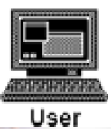
Components of a Use Case Diagram
An actor may also be shown as a class rectangle with the keyword «actor», with the usual notation for all compartments.
Other icons that convey the kind of actor may also be used to denote an actor, actor such as using a separate icon for non-human actors.
«actor»
Customer

Slide 6
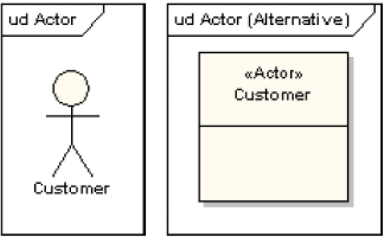
Actor: Use Case Diagram

Slide 7
Use Case
A use case is a single unit of meaningful work
It provides a high-level view of behavior observable to someone or something outside the system
The notation for a use case is an ellipse
ud use case
Use case

Slide 8

Relationship
The notation for using a use case is a connecting line with an optional arrowhead showing the direction of control
The following diagram indicates that the actor “Patient” uses the “make appointment” use case
make appointment
patient

Slide 9
System Boundary
It is usual to display use cases as being inside the system and actors as being outside the system
make appointment
Patient

Slide 10

Relationship
A relationship from an extending use case to an extended use case that specifies how and when the behavior defined in the extending use case can be inserted into the behavior defined in the extended use case.
Registration use case is meaningful on its own. It could be extended with optional Get Help On Registration use case
The point at which an extending use case is added can be defined by means of an extension point
Notes:
In UML modeling, you can use an extend relationship to specify that one use case (extension) extends the behavior of another use case (base). This type of relationship reveals details about a system or application that are typically hidden in a use case.
The extend relationship specifies that the incorporation of the extension use case is dependent on what happens when the base use case executes. The extension use case owns the extend relationship. You can specify several extend relationships for a single base use case.
While the base use case is defined independently and is meaningful by itself, the extension use case is not meaningful on its own. The extension use case consists of one or several behavior sequences (segments) that describe additional behavior that can incrementally augment the behavior of the base use case. Each segment can be inserted into the base use case at a different point, called an extension point.
The extension use case can access and modify the attributes of the base use case; however, the base use case is not aware of the extension use case and, therefore, cannot access or modify the attributes and operations of the extension use case.
You can add extend relationships to a model to show the following situations:
A part of a use case that is optional system behavior
A subflow is executed only under certain conditions
A set of behavior segments that may be inserted in a base use case
ss

Slide 11
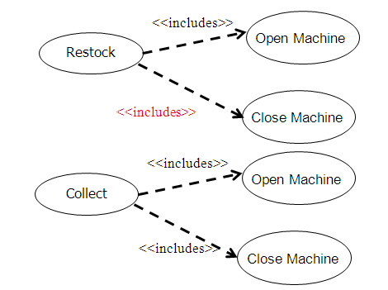
Relationship
An include relationship defines that a use case contains the behavior defined in another use case.
Notes:
In UML modeling, an include relationship is a relationship in which one use case (the base use case) includes the functionality of another use case (the inclusion use case). The include relationship supports the reuse of functionality in a use-case model.
You can add include relationships to your model to show the following situations:
The behavior of the inclusion use case is common to two or more use cases.
The result of the behavior that the inclusion use case specifies, not the behavior itself, is important to the base use case.

Slide 12
ud Include
withdraw
Card identification
<<include>>
ud Extend
patientmodify
Modify Order
Get Approval
<<extend>>

Slide 13
Relationship: Use Case Connector
The uses connector can optionally have multiplicity values at each end, as in the
following diagram
which shows that a customer may only have one withdrawal session at a time, but a bank may have any number of customers making withdrawals concurrently
ud Multiplicity
Withdraw
1
1
0..1
0..*
Customer
Bank

Slide 14
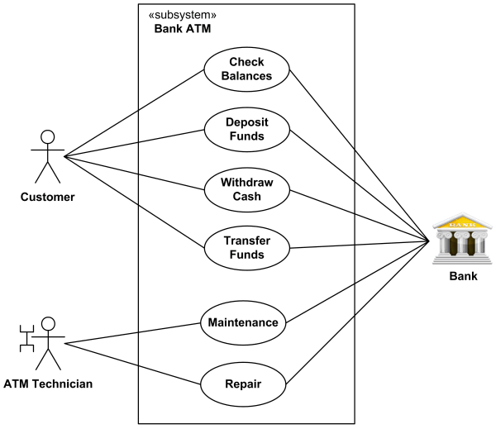
An example of use case diagram for Bank ATM subsystem
Ref: http://www.uml-diagrams.org/use-case-diagrams-examples.html#atm

Slide 15
Node Type | Notation
Actor(default)
Actor (optional user-defined icon)
Extend
Extend (with Condition)
Customer
<<extend>>
Extension point Selection
Extended (use case)
Extending (use case)
Condition: [Customer selected HELP]
extension point: Selection
<<extend>>

Slide 16
Node Type | Notation
Include
Use case
withdraw
<<include>>
Card identification
Including use case
Included use case
withdraw
On-Line Help
Extension point Selection

Slide 17
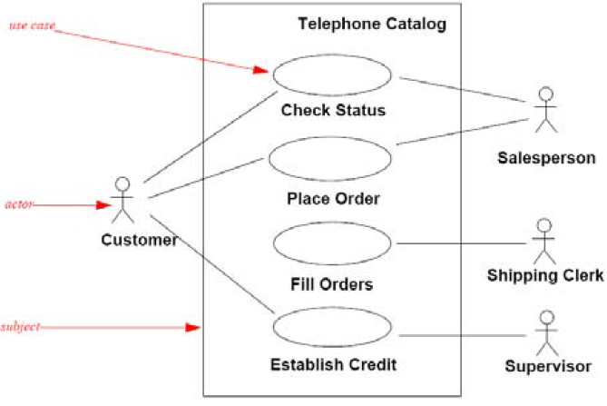
Use Case
Actor
Subject
Use case diagram with rectangle representing the boundary of the subject

Slide 18
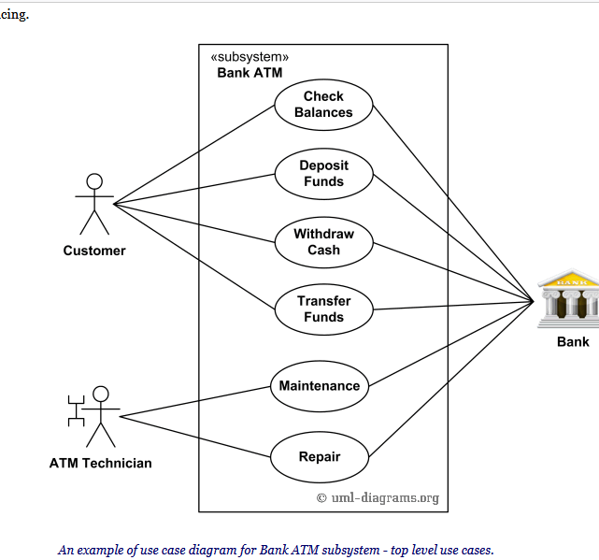
Example: Bank ATM

Slide 19
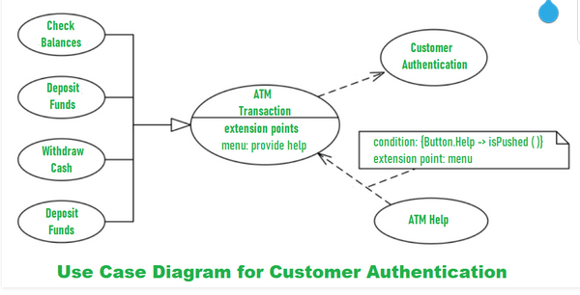
Notes:
The user is authenticated when enters the plastic ATM card in a Bank ATM. Then enters the user name and PIN (Personal Identification Number). For every ATM transaction, a Customer Authentication use case is required and essential. So, it is shown as include relationship. Example of use case diagram for Customer Authentication is shown below:

Slide 20
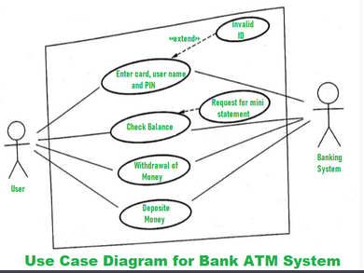
Notes:
User checks the bank balance as well as also demands the mini statement about the bank balance if they want. Then the user withdraws the money as per their need. If they want to deposit some money, they can do it. After complete action, the user closes the session.

Slide 21
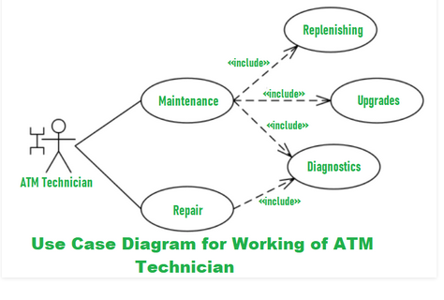
Notes:
If there is any error or repair needed in Bank ATM, it is done by an ATM technician. ATM technician is responsible for the maintenance of the Bank ATM, upgrades for hardware, firmware or software, and on-site diagnosis.

Slide 22
References
Roger S. Pressman, Software Engineering, A Practitioner’s Approach, Sixth Edition, 20005.Engineering
http://www.uml.org
http://www.sciencedirect.com/

